Slide 1
Introducing CIMERLI® (ranibizumab-eqrn)
The first and only FDA-approved biosimilar interchangeable with Lucentis® (ranibizumab injection) for all indications¹
INDICATIONS
CIMERLI® is indicated for the treatment of patients with:
Neovascular (Wet) Age-Related Macular Degeneration (AMD)
Macular Edema Following Retinal Vein Occlusion (RVO)
Diabetic Macular Edema (DME)
Diabetic Retinopathy (DR)
Myopic Choroidal Neovascularization (mCNV)
Please see the Important Safety Information throughout this slide deck and the CIMERLI® Prescribing Information at this presentation.
1. Purple Book Database of Licensed Biological Products. U.S. Food and Drug Administration. https://purplebooksearch.fda.gov/faqs. Updated 2024. Accessed June 4, 2024.

Slide 2
Important Safety Information
CONTRAINDICATIONS
CIMERLI® (ranibizumab-eqrn) is contraindicated in patients with ocular or periocular infections or known hypersensitivity to ranibizumab products or any of the excipients in CIMERLI®. Hypersensitivity reactions may manifest as severe intraocular inflammation
WARNINGS AND PRECAUTIONS
Endophthalmitis and Retinal Detachments: Intravitreal injections, including those with ranibizumab products, have been associated with endophthalmitis, retinal detachment, and iatrogenic traumatic cataract. Proper aseptic injection technique should always be utilized when administering CIMERLI®. In addition, patients should be monitored following the injection to permit early treatment, should an infection occur
Increases in Intraocular Pressure: Increases in intraocular pressure have been noted both pre-injection and post-injection (at 60 minutes) while being treated with ranibizumab products. Monitor intraocular pressure prior to and following intravitreal injection with CIMERLI® and manage appropriately
Thromboembolic Events: Although there was a low rate of arterial thromboembolic events (ATEs) observed in the ranibizumab clinical trials, there is a potential risk of ATEs following intravitreal use of VEGF inhibitors. ATEs are defined as nonfatal stroke, nonfatal myocardial infarction, or vascular death (including deaths of unknown cause)
Please see additional Important Safety Information throughout.

Slide 3
CIMERLI® (ranibizumab-eqrn) Has Attributes Identical To Lucentis® (ranibizumab injection)^{1,2*}
Same
Same
Same
Same
FDA-approved
indications
Dosage strengths
(0.3 mg & 0.5 mg)
Formulation & excipients
Amino acid sequence
*Attributes listed are not exhaustive.
1. CIMERLI® (ranibizumab-eqrn) prescribing information. Princeton, NJ: Sandoz, Inc.; 2024. 2. Data on file. Sandoz, Inc.

Slide 4
CIMERLI® (ranibizumab-eqrn) Manufacturing Process Ensures Consistent Product Quality
CIMERLI® is manufactured in state-of-the-art facilities
The facility
Manufacturing facility was purposefully designed to produce therapeutic proteins compliant with all current Good Manufacturing Practices (cGMP) standards, and has successfully completed FDA inspections.
The process
Manufacturing of CIMERLI® has demonstrated a high level of consistency.
The product
CIMERLI® approval was based on extensive data analysis and stringent FDA requirements.

Slide 5
CIMERLI® (ranibizumab-eqrn) Demonstrated Biosimilarity Based On The Totality of Evidence
Comparative analytical assessments¹
Demonstrated similarity of the structural and functional quality attributes of CIMERLI® to Lucentis®
Non-clinical studies¹
Established ocular pharmacokinetics comparable to Lucentis® in rabbit model (within the vitreous humor)
Comparative clinical study^{1,2}
Demonstrated no clinically meaningful differences in terms of efficacy, safety, and immunogenicity, as well as pharmacokinetic and pharmacodynamic evaluation in wAMD patients (COLUMBUS-AMD Study)
CIMERLI® |  | Lucentis®
 | Biological function
 | Pharmacokinetics
 | Pharmacodynamics
 | Safety proﬁle
 | Immunogenicity
 | Drug stability
 | Drug purity
1. Data on File. Sandoz, Inc. 2. Holz FG, et al. Efficacy and Safety of Biosimilar FYB201 Compared with Ranibizumab in Neovascular Age-Related Macular Degeneration. Ophthalmology. 2022.

Slide 6
Important Safety Information (Continued)
WARNINGS AND PRECAUTIONS (Continued)
Neovascular (Wet) Age-Related Macular Degeneration (wAMD)
The ATE rate in the three controlled neovascular AMD studies (AMD-1, AMD-2, AMD-3) during the first year was 1.9% (17 of 874) in the combined group of patients treated with 0.3 mg or 0.5 mg ranibizumab compared with 1.1% (5 of 441) in patients from the control arms. In the second year of Studies AMD-1 and AMD-2, the ATE rate was 2.6% (19 of 721) in the combined group of ranibizumab-treated patients compared with 2.9% (10 of 344) in patients from the control arms. In Study AMD-4, the ATE rates observed in the 0.5 mg arms during the first and second year were similar to rates observed in Studies AMD-1, AMD-2, and AMD-3
In a pooled analysis of 2-year controlled studies (AMD-1, AMD-2, and a study of ranibizumab used adjunctively with verteporfin photodynamic therapy), the stroke rate (including both ischemic and hemorrhagic stroke) was 2.7% (13 of 484) in patients treated with 0.5 mg ranibizumab compared to 1.1% (5 of 435) in patients in the control arms (odds ratio 2.2 [95% confidence interval (0.8-7.1)])
Macular Edema Following Retinal Vein Occlusion (RVO)
The ATE rate in the 2 controlled RVO studies during the first 6 months was 0.8% in both the ranibizumab and control arms of the studies (4 of 525 in the combined group of patients treated with 0.3 mg or 0.5 mg ranibizumab and 2 of 260 in the control arms). The stroke rate was 0.2% (1 of 525) in the combined group of ranibizumab-treated patients compared to 0.4% (1 of 260) in the control arms
Please see additional Important Safety Information throughout.

Slide 7
Important Safety Information (Continued)
WARNINGS AND PRECAUTIONS (Continued)
Diabetic Macular Edema (DME) and Diabetic Retinopathy (DR)
In a pooled analysis of Studies D-1 and D-2, the ATE rate at 2 years was 7.2% (18 of 250) with 0.5 mg ranibizumab, 5.6% (14 of 250) with 0.3 mg ranibizumab, and 5.2% (13 of 250) with control. The stroke rate at 2 years was 3.2% (8 of 250) with 0.5 mg ranibizumab, 1.2% (3 of 250) with 0.3 mg ranibizumab, and 1.6% (4 of 250) with control. At 3 years, the ATE rate was 10.4% (26 of 249) with 0.5 mg ranibizumab and 10.8% (27 of 250) with 0.3 mg ranibizumab; the stroke rate was 4.8% (12 of 249) with 0.5 mg ranibizumab and 2.0% (5 of 250) with 0.3 mg ranibizumab
Fatal events occurred more frequently in patients with DME and DR at baseline: A pooled analysis of Studies D-1 and D-2 showed that fatalities in the first 2 years occurred in 4.4% (11 of 250) of patients treated with 0.5 mg ranibizumab, in 2.8% (7 of 250) of patients treated with 0.3 mg ranibizumab, and in 1.2% (3 of 250) of control patients. Over 3 years, fatalities occurred in 6.4% (16 of 249) of patients treated with 0.5 mg ranibizumab and in 4.4% (11 of 250) of patients treated with 0.3 mg ranibizumab. Although the rate of fatal events was low and included causes of death typical of patients with advanced diabetic complications, a potential relationship between these events and intravitreal use of VEGF inhibitors cannot be excluded
Retinal vasculitis with or without occlusion, typically in the presence of preexisting intraocular inflammation or post-treatment with other intravitreal agents, have been reported with the use of ranibizumab products. Discontinue treatment with CIMERLI® in patients who develop these events. Patients should be instructed to report any change in vision without delay
Please see additional Important Safety Information throughout.

Slide 8
COLUMBUS-AMD Head-to-Head Study Established Clinical Equivalence Between CIMERLI® (ranibizumab-eqrn) And Lucentis® (ranibizumab injection)¹
COLUMBUS-AMD was a comparative, prospective, 48-week, evaluation-masked, parallel-group, global, multicenter, randomized study in patients with treatment-naïve, subfoveal CNV due to wAMD
Patient inclusion and exclusion criteria were well balanced between study arms:​
≥50 years
Subfoveal or juxtafoveal CNV with foveal-involving leakage related to CNV activity
FCP retinal thickness ≥350 μm on SD-OCT
Total lesion area of ≤12 MPS disc areas
Total CNV area ≥50% of total lesion area
Study eye BCVA 20/32 to 20/100
Treatment: CIMERLI®
IVT 0.5 mg (50 µl) Q4W for ≤48 weeks
N=238
Endpoints
Primary
Change in BCVA from baseline at Week 8
R 1:1
N=477
Reference Product: Lucentis®
IVT 0.5 mg (50 µl) Q4W for ≤48 weeks
N=239
Key Secondary
Change in BCVA from baseline at Week 48, change in retinal thickness from baseline at Week 48, safety and immunogenicity
BCVA, best corrected visual acuity; CNV, choroidal neovascularization; ETDRS, Early Treatment Diabetic Retinopathy Study; FCP, foveal center point; IVT, intravitreal; MPS, macular photocoagulation study; ​nAMD, neovascular age-related macular degeneration; Q4W, every 4 weeks; R, randomized; SD-OCT, spectral domain optical coherence tomography.​
1. Holz FG, et al. Efficacy and Safety of Biosimilar FYB201 Compared with Ranibizumab in Neovascular Age-Related Macular Degeneration. Ophthalmology. 2022.

Slide 9
Baseline Patient Population And Characteristics Were Well Balanced Between CIMERLI® (ranibizumab-eqrn) And Lucentis® (ranibizumab injection) Study Arms¹
Patient baseline characteristics
 | CIMERLI® (n=238) | Lucentis® (n=239) | Total (N =477)
Sex, female/male, no. (%) | 135 (56.7)/103 (43.3) | 134 (56.1)/105 (43.9) | 269 (56.4)/208 (43.6)
Age (yrs), median (range) | 76 (50–91) | 77 (50–94) | 76 (50–94)
Age group (yrs), no. (%)
50–64 | 25 (10.5) | 19 (7.9) | 44 (9.2)
65–75 | 91 (38.2) | 86 (36.0) | 177 (37.1)
>75 | 122 (51.3) | 134 (56.1) | 256 (53.7)
Study eye, right eye, no. (%) | 127 (53.4) | 127 (53.1) | 254 (53.2)
Study eye Snellen equivalent, no. (%)
20/32 | 24 (10.1) | 22 (9.2) | 46 (9.6)
20/40 | 43 (18.1) | 38 (15.9) | 81 (17.0)
1. Holz FG, et al. Efficacy and Safety of Biosimilar FYB201 Compared with Ranibizumab in Neovascular Age-Related Macular Degeneration. Ophthalmology. 2022.

Slide 10
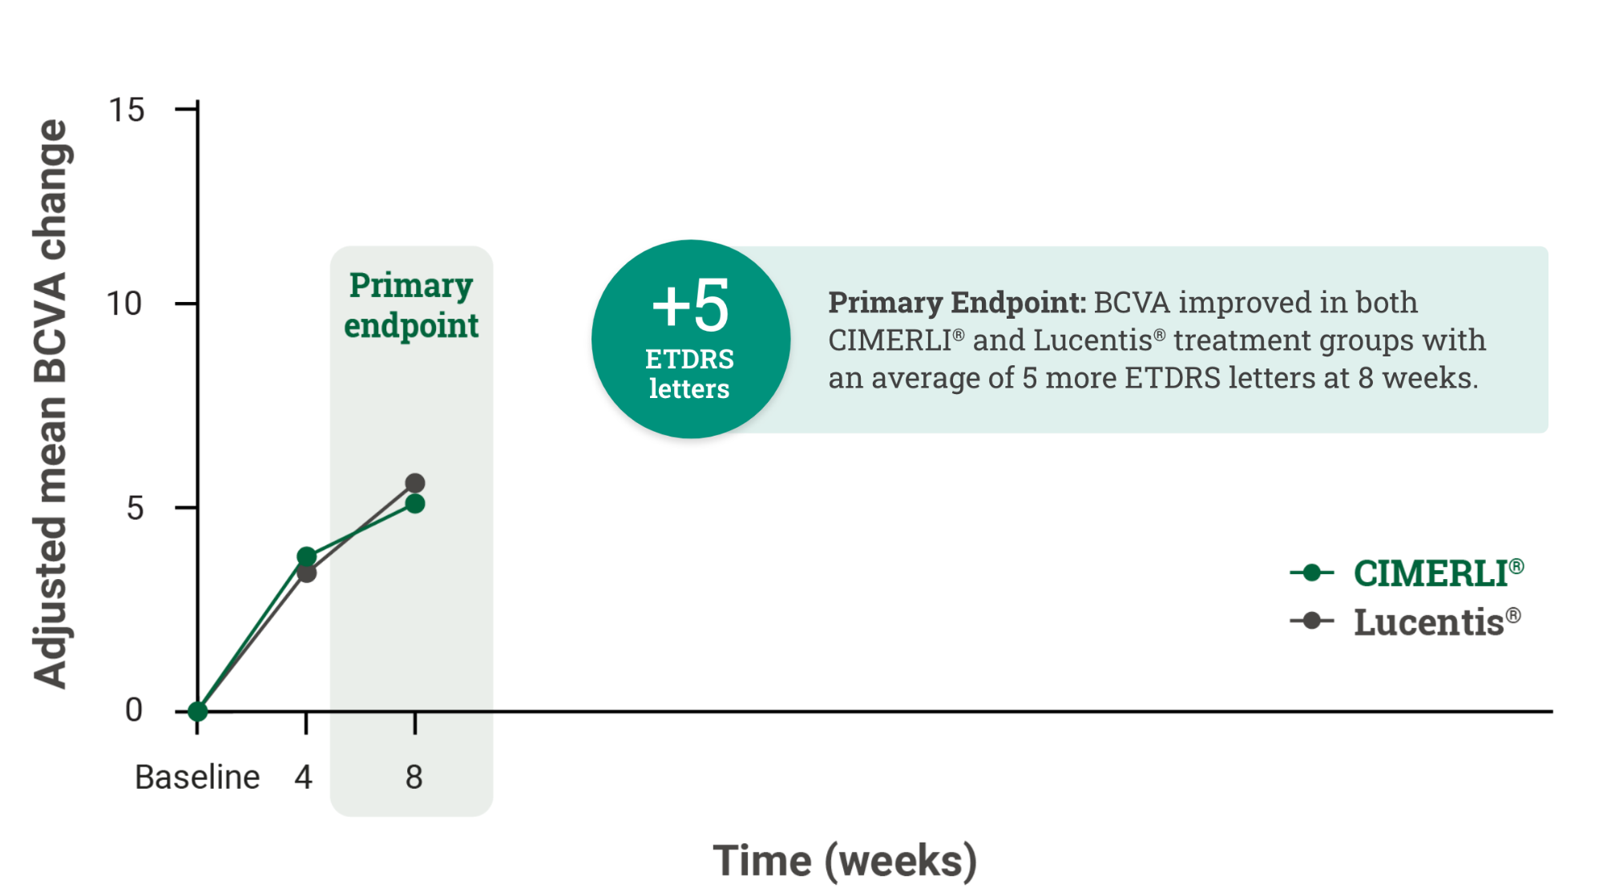
CIMERLI® (ranibizumab-eqrn) Demonstrated Equivalent Efficacy To Lucentis® (ranibizumab injection): Primary Endpoint At Week 8
*
Key Takeaway
Rate of improvement in BCVA is especially steep during the initial 8-week period, clearly highlighting any difference in efficacy between products, should one exist.
1,2
*The analysis of covariance (ANCOVA) least squares mean difference for the change from baseline between CIMERLI® and Lucentis® was –0.4 ETDRS letters with a 90% confidence interval (CI) of –1.6 to 0.9,​ which was within the predefined equivalence margin of –3.5 to 3.5.
1. Data on File. Sandoz, Inc. 2. Holz FG, et al. Efficacy and Safety of Biosimilar FYB201 Compared with Ranibizumab in Neovascular Age-Related Macular Degeneration. Ophthalmology. 2022.

Slide 11
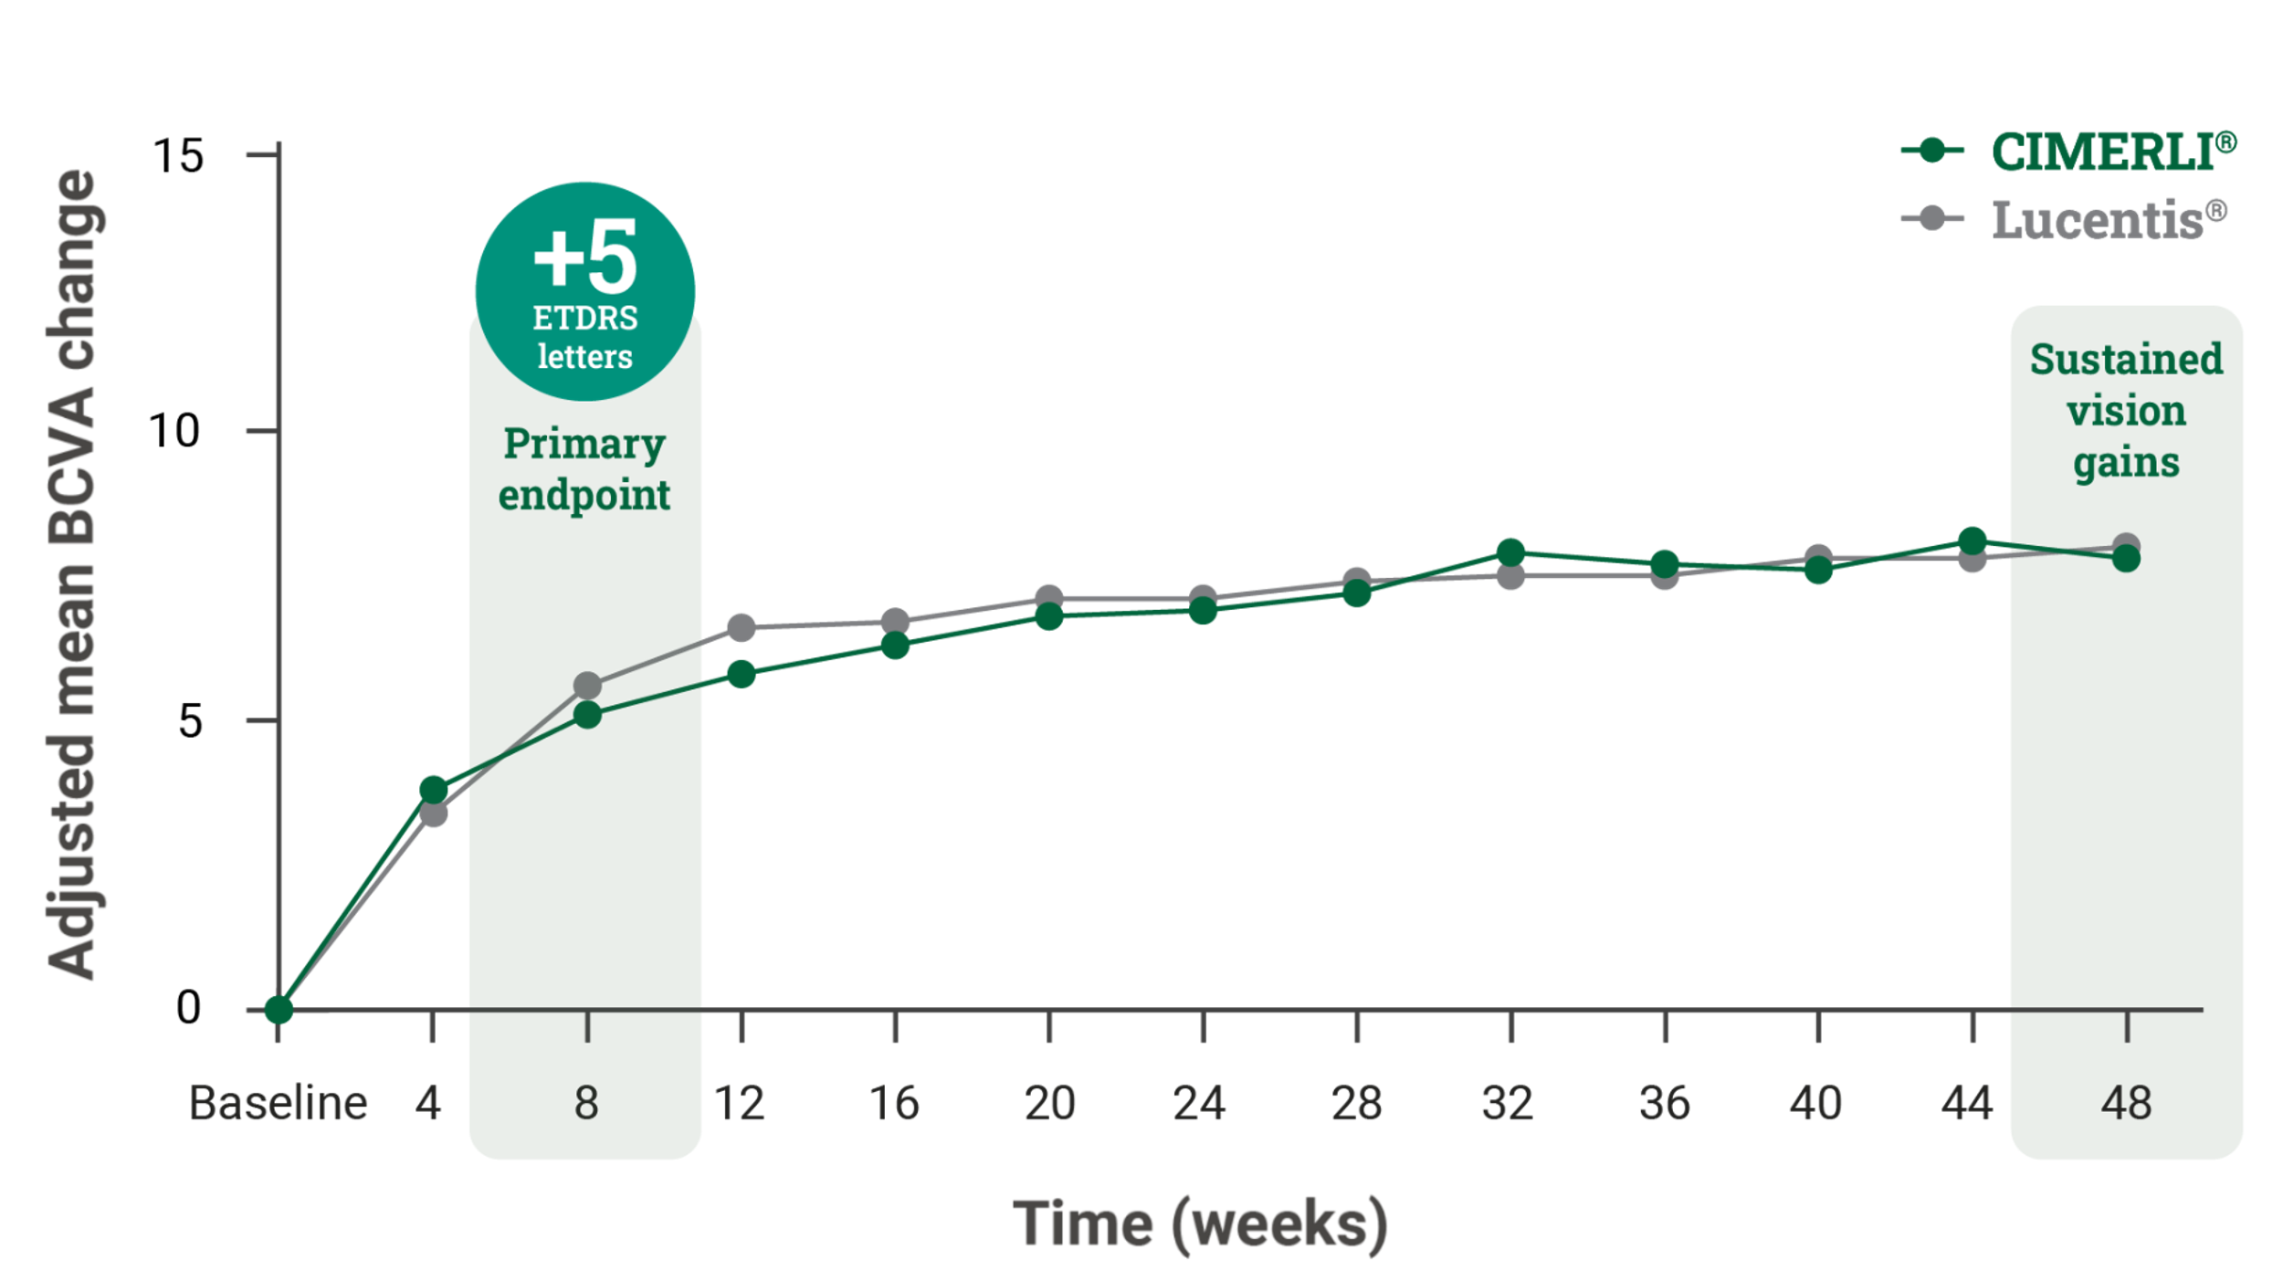
CIMERLI® (ranibizumab-eqrn): Proven Vision Gains At Week 8 And Sustained Through Week 48
*
Primary Endpoint: BCVA improved in both CIMERLI® and Lucentis® treatment groups with an average of 5 more ETDRS letters at 8 weeks.^{1,2}
Secondary Endpoint: BCVA improved in both CIMERLI® and Lucentis® treatment groups with an average of 8 more ETDRS letters at 48 weeks. ^{1,2}
*The analysis of covariance (ANCOVA) least squares mean difference for the change from baseline between CIMERLI® and Lucentis® was –0.4 ETDRS letters with a 90% confidence interval (CI) of –1.6 to 0.9,​ which was within the predefined equivalence margin of –3.5 to 3.5.
1. Data on File. Sandoz, Inc. 2. Holz FG, et al. Efficacy and Safety of Biosimilar FYB201 Compared with Ranibizumab in Neovascular Age-Related Macular Degeneration. Ophthalmology. 2022.

Slide 12
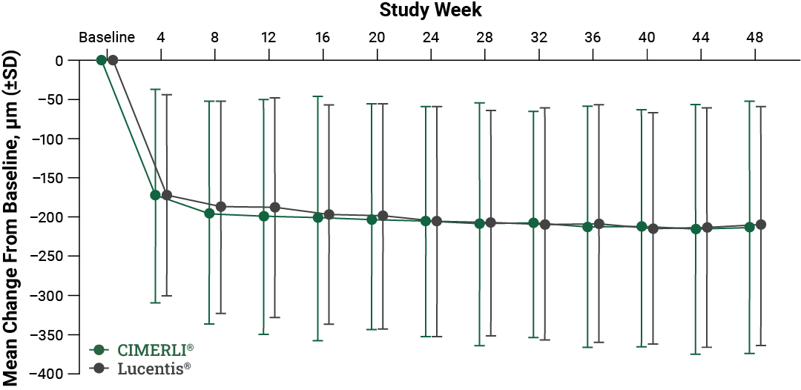
CIMERLI® (ranibizumab-eqrn) Sustained Reduction in Retinal Thickness Through Week 48
Secondary Endpoint:
Mean reduction in foveal center point (FCP) thickness at Week 48 from baseline of 213.3 μm CIMERLI® and 211.0 μm Lucentis®.¹
1. Holz FG et al. Efficacy and Safety of Biosimilar FYB201 Compared with Ranibizumab in Neovascular Age-Related Macular Degeneration. Ophthalmology. 2022.

Slide 13
CIMERLI® (ranibizumab-eqrn) Demonstrated A Comparable Safety Profile To Lucentis® (ranibizumab injection) At Week 48¹
Most frequently observed drug-related adverse events (AEs)
Adverse Reaction | CIMERLI® % (n=238) | Lucentis® % (n=239)
Cataract | 0.0% (0) | 2.1% (5)
Retinal Pigment Epithelium Tear | 0.4% (1) | 1.3% (3)
Reduced Visual Acuity | 0.0% (0) | 1.3% (3)
Vitreous Hemorrhage | 0.4% (1) | 0.4% (1)
Eye Pain | 0.8% (2) | 0.0% (0)
Increased Gamma-Glutamyl Transferase Level | 0.4% (1) | 0.8% (2)
Increased Intraocular Pressure | 1.3% (3) | 0.8% (2)
Intraocular Inﬂammation* | 0.8% (2) | 0.8% (2)
*Among CIMERLI® patients, one case of iridocyclitis and one case of conjunctivitis were observed; two cases of punctuate keratitis were observed among Lucentis® patients.
1. Holz FG, et al. Efficacy and Safety of Biosimilar FYB201 Compared with Ranibizumab in Neovascular Age-Related Macular Degeneration. Ophthalmology. 2022.

Slide 14
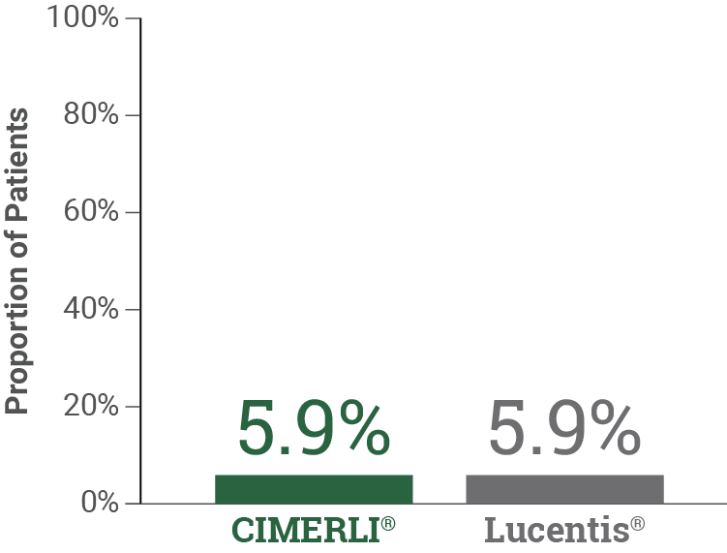
CIMERLI® (ranibizumab-eqrn) Demonstrated An Immunogenicity Profile Comparable To Lucentis® (ranibizumab injection)¹
Few patients developed anti-drug antibodies (ADA) during the study and had similar levels of ADA titers across treatment arms*
No neutralizing antibodies (NAbs) were detected up to Week 24, one patient tested positive for NAbs up to Week 48 (CIMERLI®)
*The clinical significance of immunoreactivity to ranibizumab is unclear at this time.
Incidence of Anti-Drug Antibodies (ADAs)
1. Holz FG, et al. Efficacy and Safety of Biosimilar FYB201 Compared with Ranibizumab in Neovascular Age-Related Macular Degeneration. Ophthalmology. 2022.

Slide 15
Summary
COLUMBUS-AMD study established clinical biosimilarity of CIMERLI® to Lucentis® (ranibizumab injection)
CIMERLI® demonstrated clinical equivalence to reference product Lucentis® in patients with newly diagnosed nAMD, in terms of:
Clinical efficacy
Safety (local and systemic)
Immunogenicity
CIMERLI®, an FDA-approved interchangeable ranibizumab biosimilar, serves as a treatment option for patients with:
Neovascular (wet) AMD
Macular edema following retinal vein occlusion (RVO)
Diabetic macular edema (DME)
Diabetic retinopathy (DR)
Myopic choroidal neovascularization (mCNV)

Slide 16
Important Safety Information (Continued)
ADVERSE REACTIONS
Serious adverse events related to the injection procedure have occurred in <0.1% of intravitreal injections, including endophthalmitis, rhegmatogenous retinal detachment, and iatrogenic traumatic cataract.
The most frequently reported ocular adverse reactions in ranibizumab-treated patients compared with the control group were conjunctival hemorrhage, eye pain, vitreous floaters, and increased intraocular pressure
As with all therapeutic proteins, there is the potential for an immune response in patients treated with ranibizumab. The clinical significance of immunoreactivity to ranibizumab is unclear at this time
Please see additional Important Safety Information throughout.

Slide 17
Important Safety Information (Continued)
Postmarketing Experience
The following adverse reaction has been identified during post-approval use of ranibizumab products:
Ocular: Tear of retinal pigment epithelium among patients with neovascular AMD
To report SUSPECTED ADVERSE REACTIONS, contact Sandoz, Inc at 1-800-525-8747 or FDA at 1-800-FDA-1088 or www.fda.gov/medwatch.
Before prescribing, please see CIMERLI® Prescribing Information.
©2024 Sandoz, Inc.
100 College Road West, Princeton, NJ 08540
www.sandoz.com
MLR-1620-US 10/2024

